Slide 1

Heat Cat warning

Slide 2
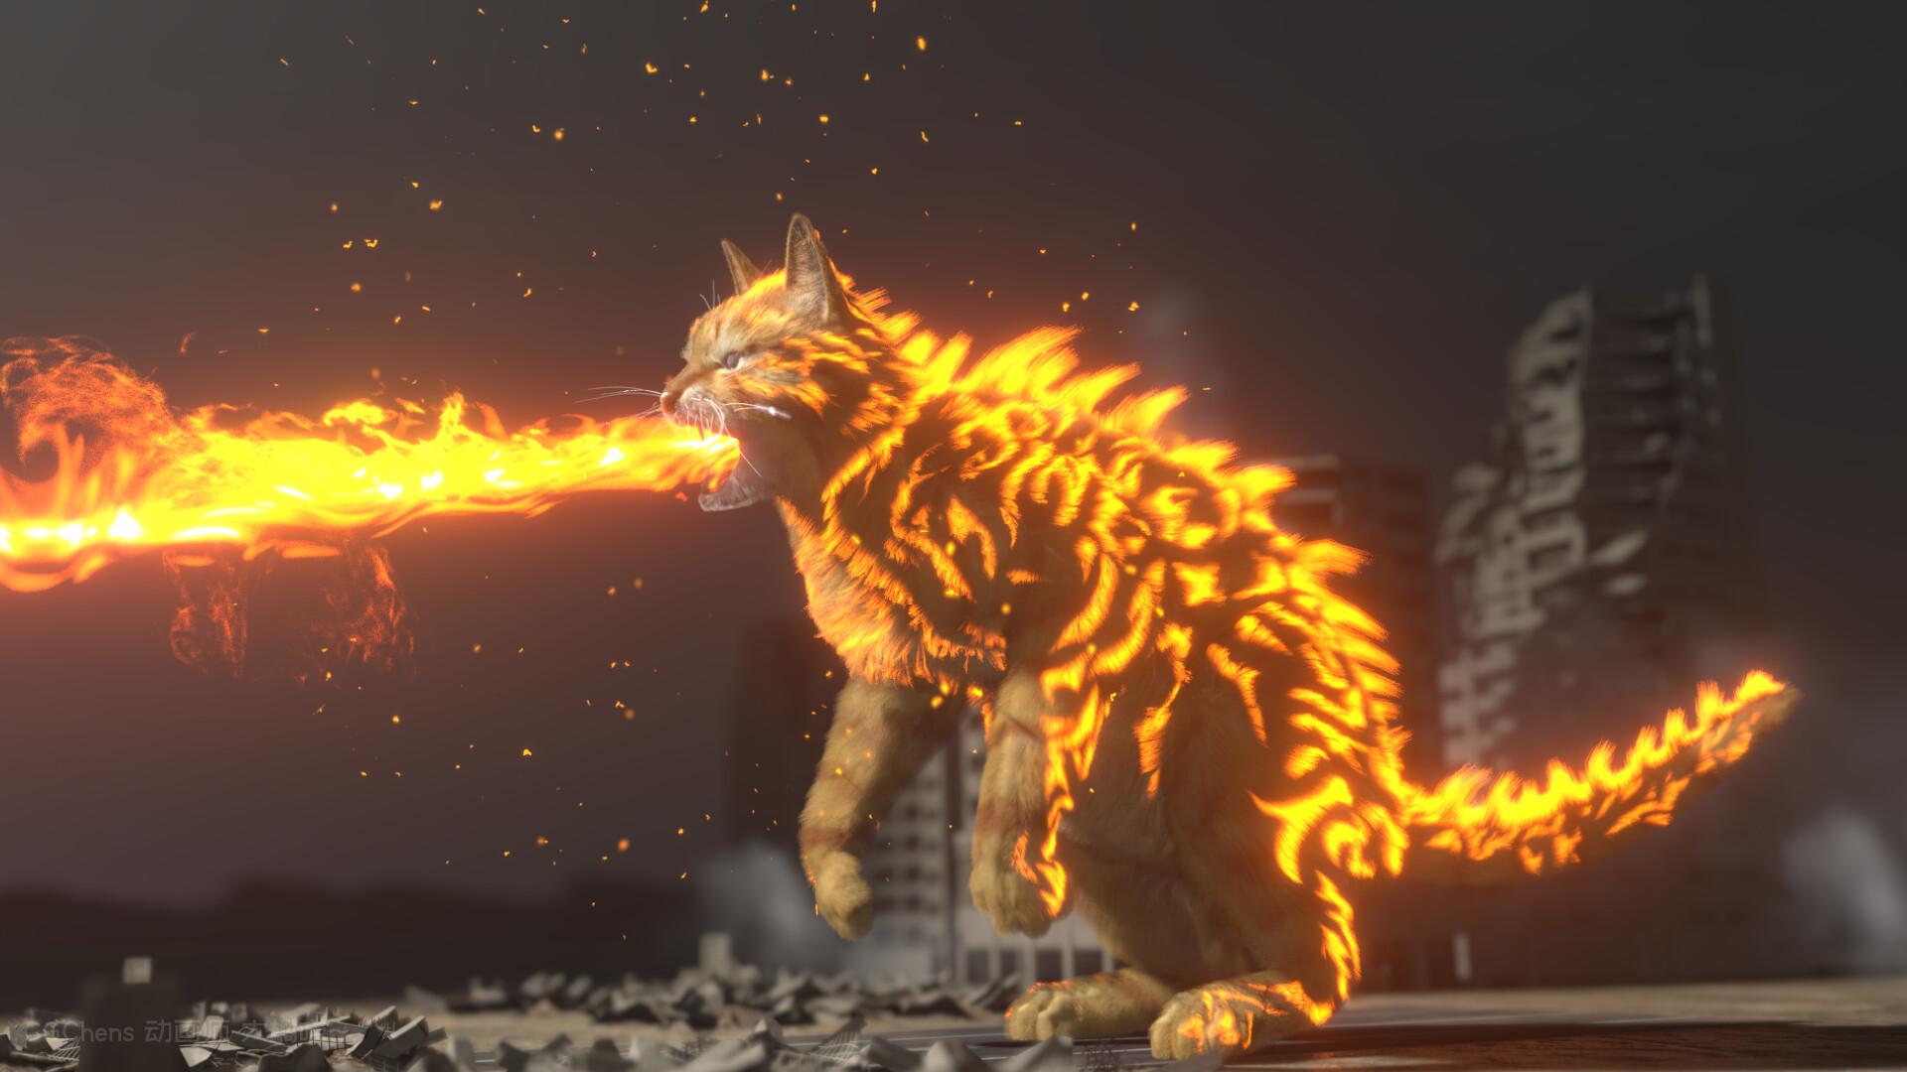
Beware

